Slide 1





“An Investment in Knowledge Pays The Best Dividend”
PRESENTED BY
Val Majewski
Vincent J. Bono, J.D.
Carolyn Marie Tobin, MA
If you have any questions, please email them to Carolyn Tobin:
Carolyn@federalwebinars.com

Slide 2
In the Summer of 2003, the Founders of our company were asked to assess the federal retirement system and the various components of the TSP.
Much to their surprise, they found that the TSP Funds were not truly managed to maximize gains for the federal employees or minimize their losses.
They also found that federal employees were not being shown how to maximize their federal pension or social security incomes, nor were they being taught how to properly plan for their retirement.
Why We Conduct These Webinars
If you have any questions about your federal retirement
email Carolyn@federalwebinars.com

Slide 3


Approved Webinar Hosts
Our “Approved Webinar Hosts” are well vetted by us, and experts in helping federal employees better plan for their retirement. By agreement with us, our “Approved Webinar Hosts” do not charge federal employees for any of their retirement consultation services or reports, no matter how extensive their reports or retirement planning advice might be.
Next week, when your Approved Webinar Host contacts you to answer any questions you might have about the content contained in this webinar, we suggest you reach back out to them, and take advantage of their federal retirement planning expertise.
Nothing is ever done in person; it is accomplished on the phone utilizing the internet portals we built exclusively for Federal Employees
If you have any questions about your federal retirement
email Carolyn@federalwebinars.com

Slide 4

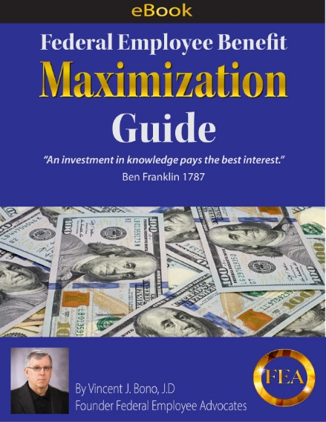
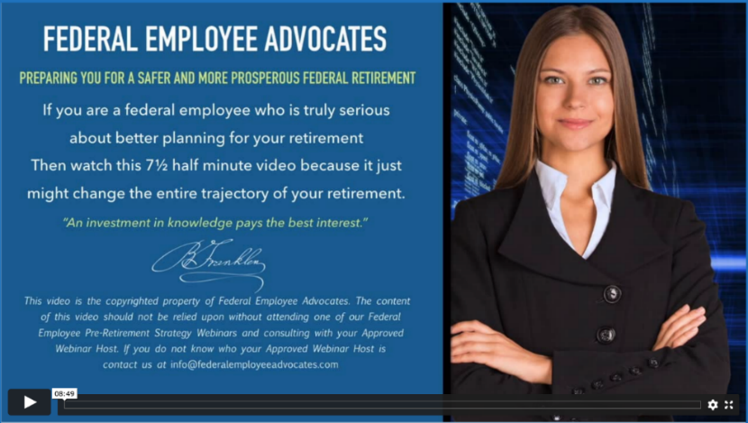
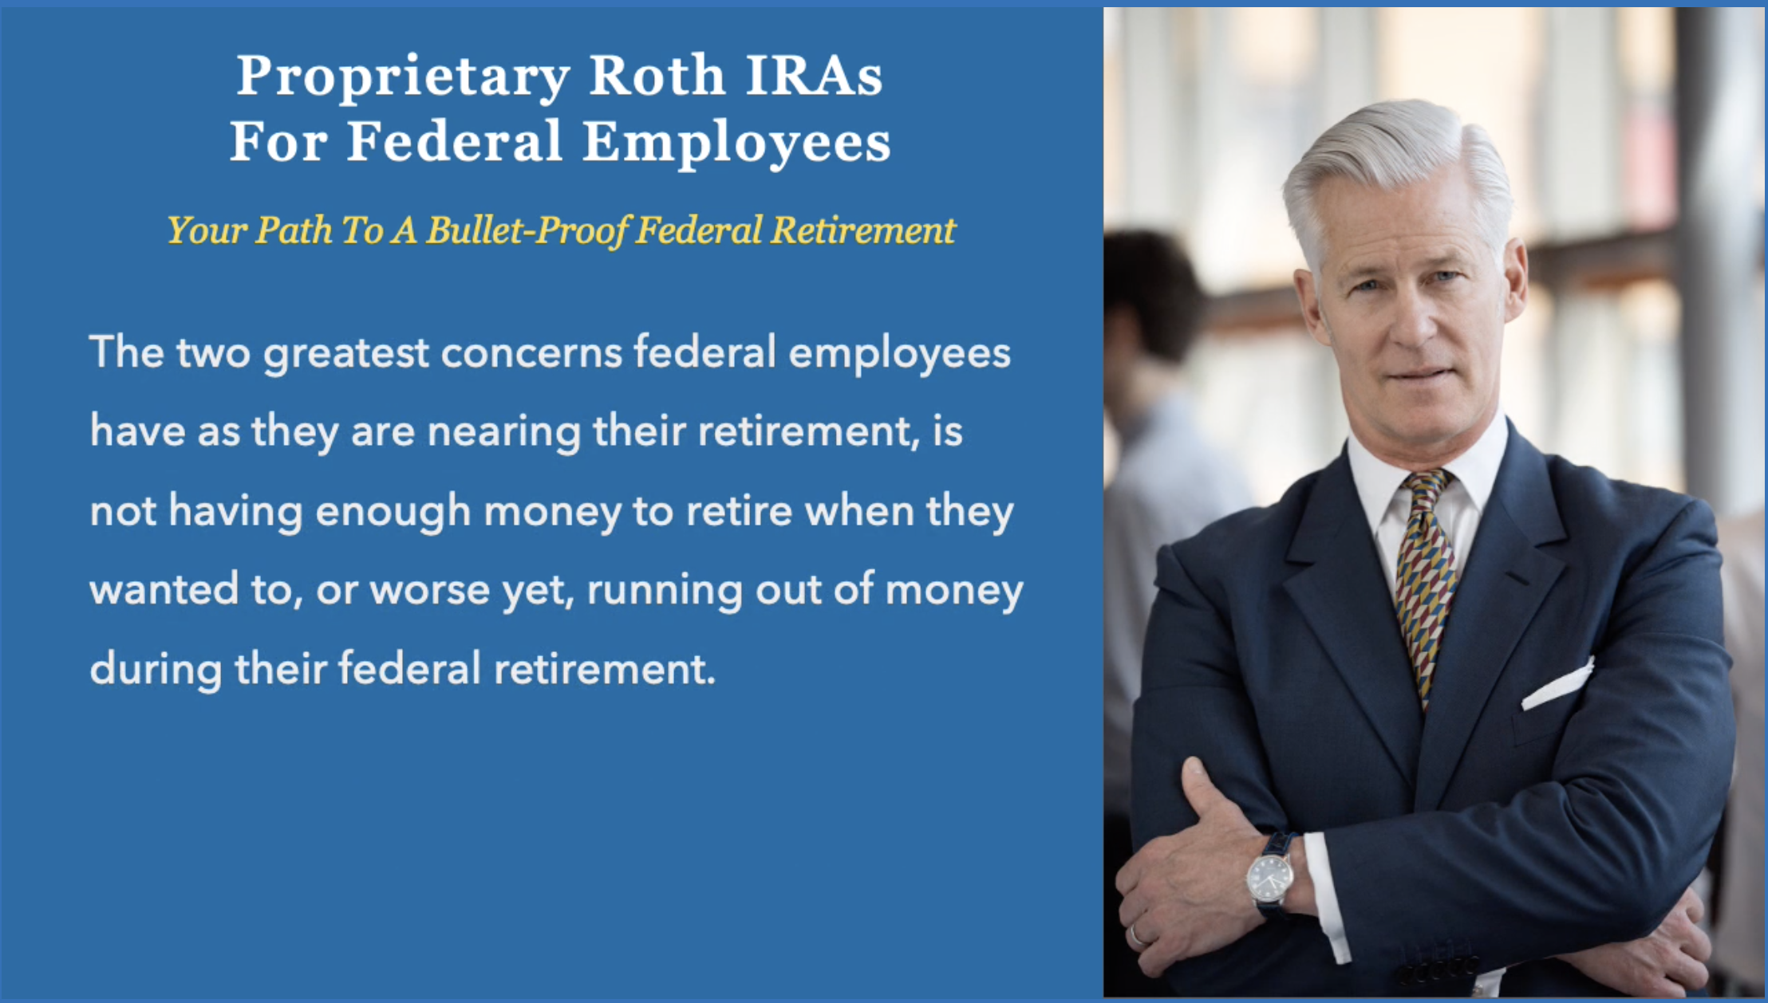
Ask Carolyn For These Free Resources
Carolyn@federalwebinars.com
Online FR80 Calculator Tutorial
eBook
Two “Must See” 6 Minute Videos

Slide 5
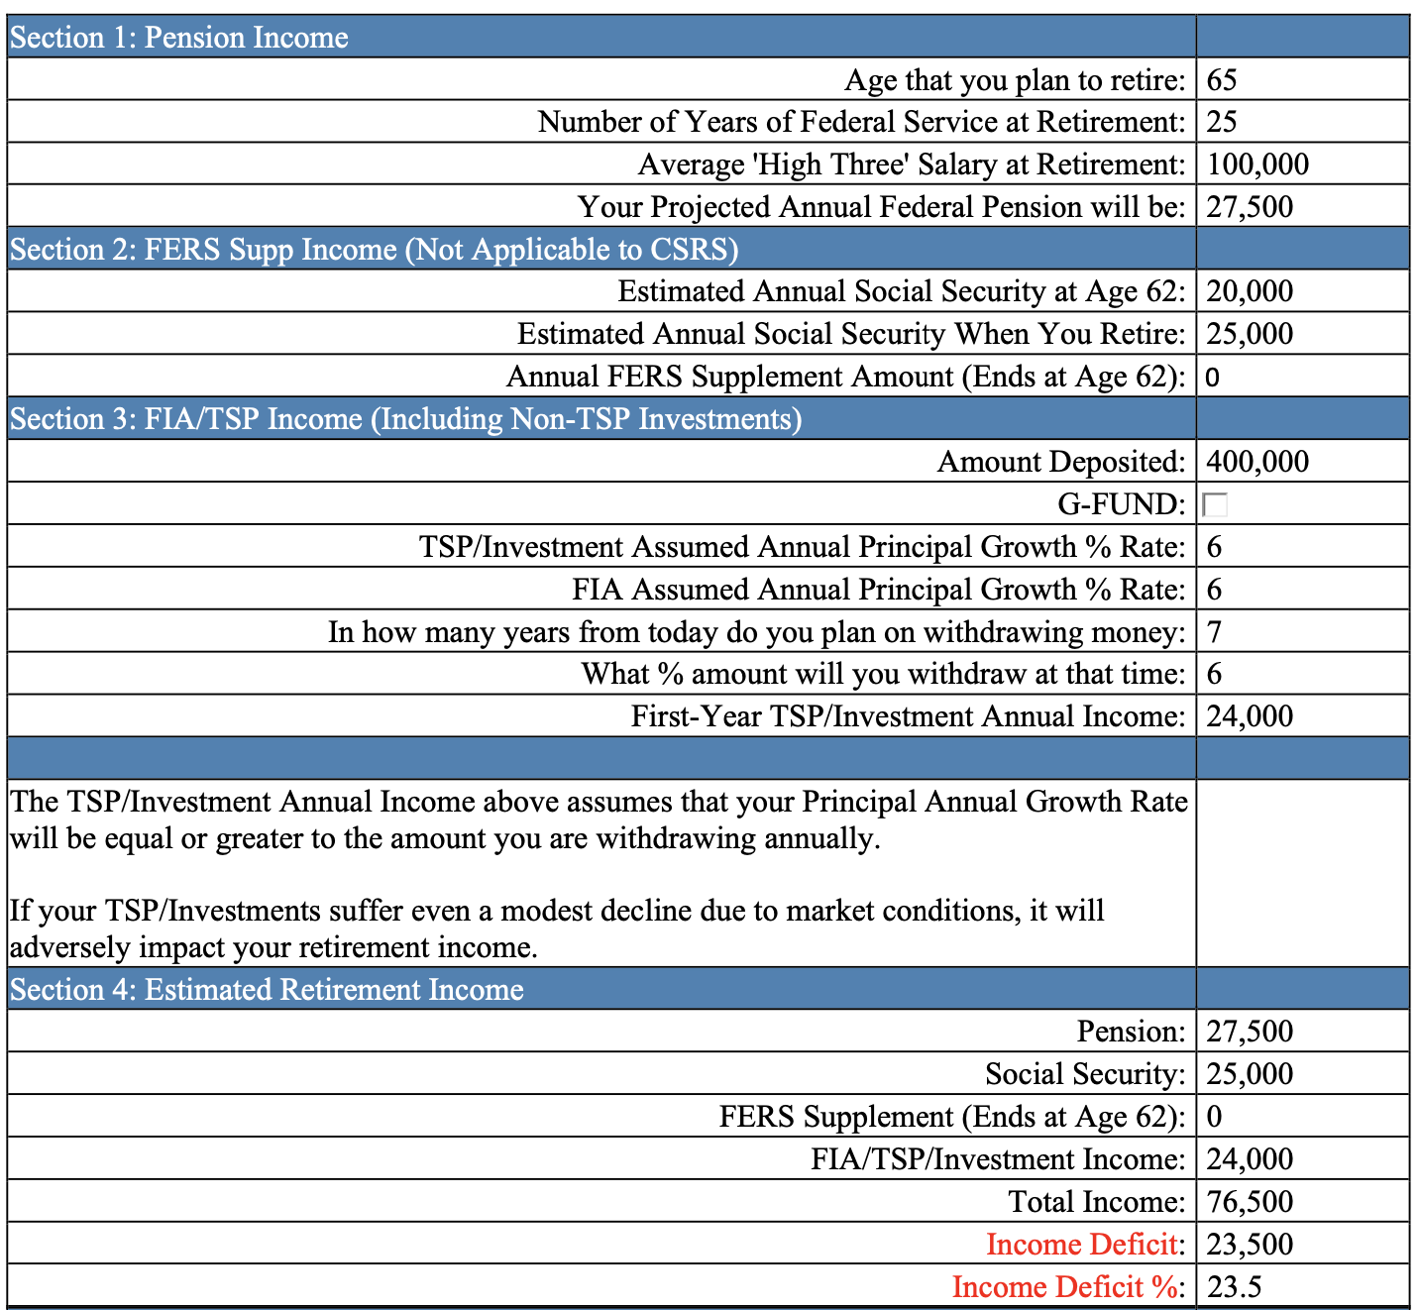
FR 80 Calculator (Income Projection)

Slide 6
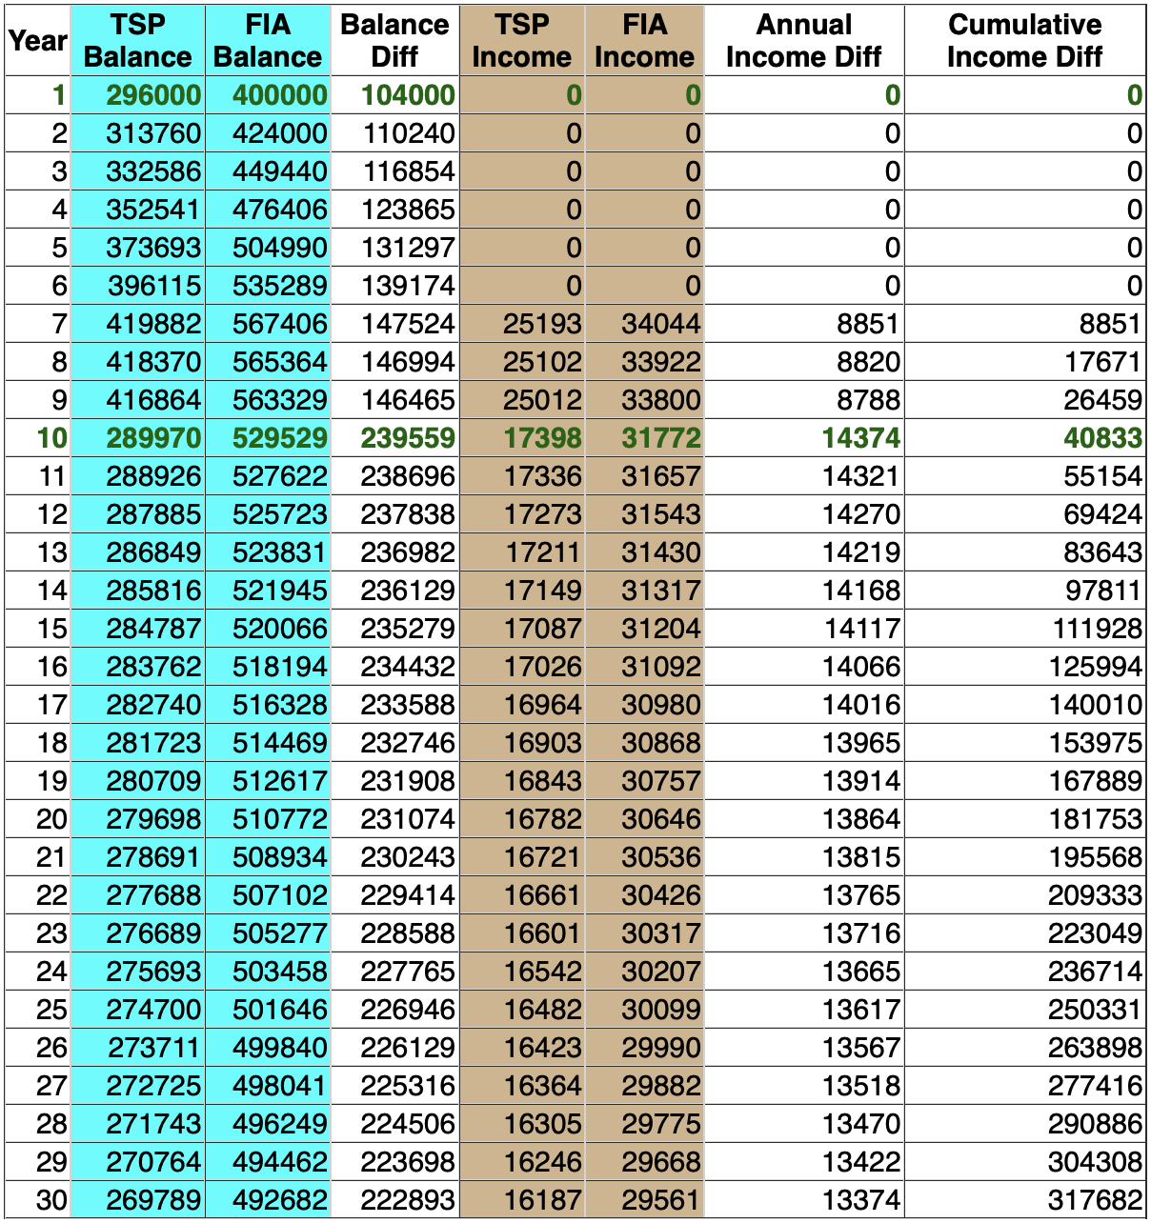
FR 80 Calculator ( TSP Growth Projection)

Slide 7
Making the right “percentage allocation” between the TSP Funds could add 33% to your account over time.
G Fund: The G Fund buys a nonmarketable U.S. Treasury security that is guaranteed by the U.S. Government, so it can’t lose money.
F Fund: Government, corporate, and mortgage-backed bonds. Attempts to match the performance of the Barclays Capital U.S. Aggregate Bond Index
C Fund: Attempts to match the performance of the S&P 500
S Fund: Attempts to match the performance of the Dow Jones U.S. Completion TSM Index
I Fund: Attempts to match the performance of the MSCI EAFE Index
L Funds: Invested in the G, F, C, S, and I Funds. The closer you are to the Fund Expiration Date (2030, 2040, 2050), the more it is weighted to the G Fund. The Further out the Expiration Date, the more it is weighted to the C, S, and I Funds)
How The TSP Funds Earn Money
If you have any questions about your federal retirement
email Carolyn@federalwebinars.com

Slide 8

TSP Fund “Allocation Maximization”
Six Undisputed Facts
Fact: During the past 10 years the I Fund earned 50% less than the C&S Funds.
Fact: The I Fund has lost money in years where the C & S Funds made money.
Fact: The G Fund earned 4.22% in 2023, 2.98 % in 2022, 1.3% in 2021 and 2.23% during the past 10 years. In essence the G Fund does lose money because it does not keep up with inflation and there are “lost opportunity costs” associated with owning it i.e. you could have done better with an FIA.
Fact: The L Fund has a significant amount invested in the I Fund and G Fund.
Fact: The C & S Funds have a huge downside exposure because they are “Administered” and not “Managed” to maximize gains and minimize losses.
Fact: If you are retiring within the next 12 years, your retirement savings should not be at risk to lose value…So how do you protect yourself?
If you have any questions about your federal retirement
email Carolyn@federalwebinars.com

Slide 9
Time Value Of Money
G Fund Vs. Tax Qualified Alternative
By way of example, if you have $100,000 in the G Fund today, and contribute $5000 a year going forward…
In 20 years, at the historic 2.32% G Fund average interest rate, you would have $288,996.
With a Tax Qualified TSP Alternative that can not lose money due to market conditions, earning 5.25%, you would have $456,933 in 20 years; a $167,937 difference.
Ask Carolyn about this TSP Alternative!
If you have any questions about your federal retirement
email Carolyn@federalwebinars.com

Slide 10

Algorithm Generated TSP Fund Allocations “SAIA”
These numbers could change dramatically based on exogenous events:
FUND | Low Risk | Medium Risk | Aggressive
C | 2% | 5% | 7%
S | 2% | 5% | 7%
I | 0% | 0% | 0%
L | 5% | 8% | 12%
F | 0% | 2% | 5%
G | 91% | 80% | 69%
If you have any questions about your federal retirement
email Carolyn@federalwebinars.com

Slide 11

Eligibility for “Normal” Voluntary Retirement When You Can Retire With No Strings Attached
CSRS: FERS:
Age 55 & 30 Years *MRA & 30 Years
Age 60 & 20 Years Age 60 & 20 Years
Age 62 & 5 Years Age 62 & 5 Years
-----------------------------------------------------------------------------------------
*Exception: FERS "MRA Plus 10"
MRA Plus 10 Warning: There is a 5% per year reduction if you are under age 62 when you start collecting under MRA Plus10. Ex: If you start collecting at age 57, your pension amount would be permanently decreased by 25%.
The FR 80 Calculator takes all of the above into account, including the calculation for Special Category Federal Employees
Exception: You can avoid the penalty if you leave federal service but apply for your pension at age 62.
If you have any questions about your federal retirement
email Carolyn@federalwebinars.com

Slide 12

Your Pension Calculation
These calculations are built into our FR 80 Calculator
FERS
CSRS
Age 62 and 20 Years of Service at Retirement:
1.1% X Your High Three X your number of years of service at retirement
Otherwise: 1.0% X Your High Three X your number of years of service at retirement
1.5% of your High Three First 5 Years
1.75% of your High Three Next 5 Years
2.0% Every Year thereafter
If there is not a pension contribution on your part, it’s not in your High Three
Accrued Sick Leave>Vacation Pay
If you have any questions about your federal retirement
email Carolyn@federalwebinars.com

Slide 13

Survivor Benefits Plan (SBP) Overview
Provides lifetime income to surviving spouse in the event the federal employee passes away first in retirement.
    CSRS – up to 55%
    FERS – 50% or 25%
Pay a premium and receive a reduced pension.
Pension Reductions:
    CSRS – approx. 10% of chosen Benefit Base
    FERS – 10% or 5%
Lack of options in retirement & death
FEHB are attached the SBP program
If you have any questions about your federal retirement
email Carolyn@federalwebinars.com

Slide 14

Social Security
Income Based Reductions
If you have not reached your “Social Security Full Retirement Age” (65, 66 or 67) and start collecting, for every $2.00 you earn above $22,320 your benefit will be reduced by $1.00. Your pension income is not included-only Wages & Business income.
This Income Based Reduction also applies to the FERS Special Supplement.
Once you achieve your “Social Security Full Retirement Age”, there are no reductions, regardless of your income.
In the year you reach your “Social Security Full Retirement Age”, you can earn $59,,520 without any reduction of benefits. For every $3.00 over that amount, your benefit will be reduced by $1.00.
If you have any questions about your federal retirement
email Carolyn@federalwebinars.com
14

Slide 15

Social Security
Age Based Reductions/Increases
If you start collecting Social Security before your “Social Security Full Retirement Age” (65, 66 or 67), your payments will reduced by 6.25% for every year earlier that you start to collect.
Example: Assuming your Social Security FRA is age 66, collecting at age 62 causes a permanent 25% reduction (6.25% x the four years until your FRA). If you started collecting at Age 64=12.5% reduction.
This is a permanent reduction!
If you retire & start collecting at age 70, your payments will be 32.5% more than if you retired & collected at your FRA, again assuming your Social Security FRA is 66.
Age 78 1/2 is your “Break Even” Point if you wait until your FRA.
If you have any questions about your federal retirement
email Carolyn@federalwebinars.com

Slide 16
Social Security
Age Based Reductions/Increases
62 year-old federal employee with a Social Security Full Retirement age of 66.
If social Security is taken at Age 66 assume the benefit , will be $2000 a month.
If taken at age 62, the benefit will be $1500 a month.
If taken at age 70, the benefit will be $2640 a month
If you have any questions about your federal retirement
email Carolyn@federalwebinars.com

Slide 17

When You Can Access Your TSP Money
TSP Modernization Act Effective September 15th, 2019:
If you are still working at your federal job and are over age 59 ½, you are allowed Four withdrawals every year.
If you are separated from federal service, your withdrawals are unlimited, but must be 30 days apart.

Slide 18

What Can You Do With Your TSP Money
Post Retirement:
Leave your money in the TSP and take withdrawals.
Post Retirement:
Swap out your TSP money for a MetLife guaranteed income annuity.
At age 59 ½ while you are still working or Post Retirement:
Transfer your money to the company of your choice, where you can participate in the upside of the stock market without any market risk.
That is what the next 5 minutes is all about…..
If you have any questions about your federal retirement
email Carolyn@federalwebinars.com

Slide 19

Fixed Indexed Annuities: The Best of Both Worlds
They are Safe & Secure
Like your TSP C, S, I & L Funds, Fixed Indexed Annuities participate in the upside of the Stock Market.
Built-In Safety Valves
Unlike those TSP Funds, Fixed Indexed Annuities are not impacted to the downside due to “Stock Market Conditions”.
Unlike those TSP Funds, Fixed Indexed Annuities can not have prior gains “Clawed Back” due to “Market Conditions”.
An example of a Claw-Back is what happened in 2022. If you had your money in the S Fund, you lost 26.66% in 2022, so all of your gains in 2021 and 50% of your gains in 2020 were “Clawed-Back”
If you have any questions about your federal retirement
email Carolyn@federalwebinars.com

Slide 20
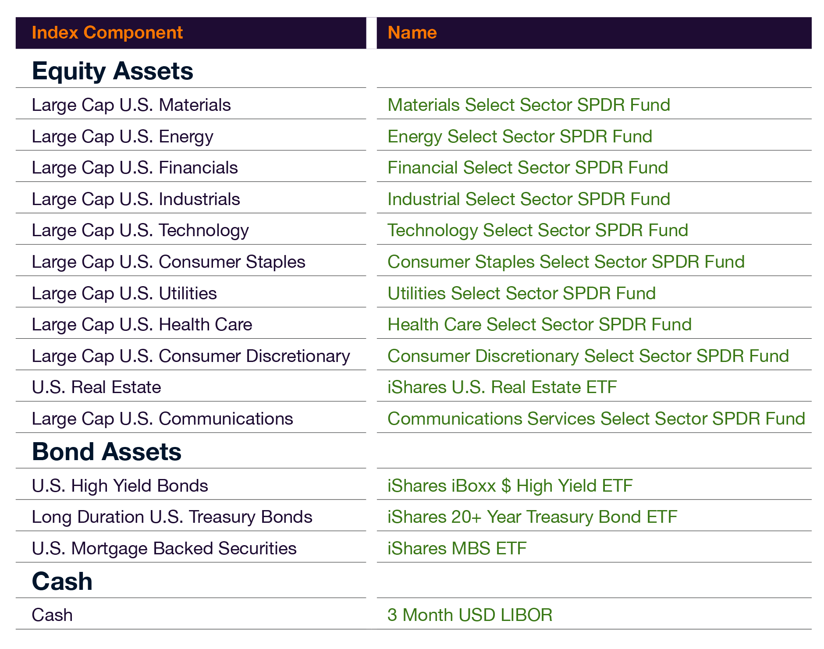
Actual FIA Managed Index Components
Without The Predatory 1.5% “Management Fees”
If you have any questions about your federal retirement
email Carolyn@federalwebinars.com

Slide 21


How Fixed Indexed Annuities Earn Money
The performance of Fixed Index Annuities”, are attached to “Managed Indexes”, that have strong upside potential.
These are Benchmark Indexes created by well known, Multi-Billion Dollar Companies
16 of 48 Managed Indexes Inside Annuities
Barclays Trailblazer Sector 5
Fidelity Multi Factor Yield
JP Morgan Mozaic II
BlackRock Volatility Control
Janus SG MC
Shiller Barclays
S&P 500 Low-Vol Index
Credit Suisse Momentum
Merrill Lynch RPM
JP Morgan Strategic Balance
BPN Mad5
Pimco Balanced
NYSE Zebra
BPN Paribus
Morning Star Div5
S&P 500 Aristocrats
If you have any questions about your federal retirement
email Carolyn@federalwebinars.com

